Slide 1
Welcome
Self Neglect: Learning from SAR
Older Adult Domestic Abuse: Learning from Research
Terri Banks Head of Safeguarding Children & Adults
Title of Presentation goes here

Slide 2
Welcome
Self Neglect: Learning from Safeguarding Adult Reviews
Title of Presentation goes here

Slide 3
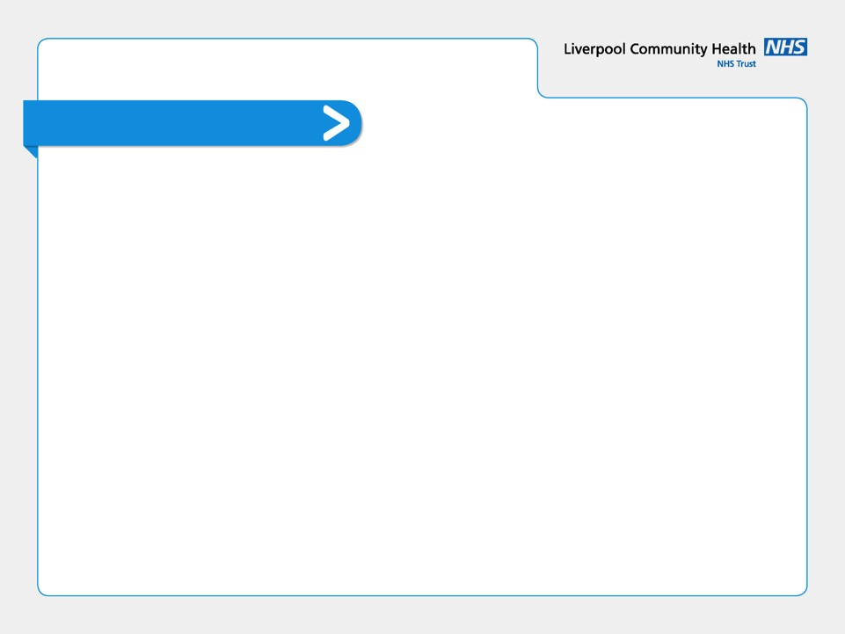
What is Self-Neglect
Self-neglect is abuse of self.
It differs from the other forms of abuse because it does not involve a perpetrator
It is frequently associated with hoarding and older people, but applies equally to all adult age groups
It is a refusal or failure of an individual to provide themselves with adequate food, water, clothing, shelter, personal hygiene, healthcare, medication and safety precautions

Slide 4
The Study
Self-neglect commonly poses complex challenges to the agencies and practitioners involved.
Systemic review of the findings from 40 Safeguarding Adult Reviews involving adults who self-neglect (Braye, Orr, and Preston-Shoot (2015))
The study comprised a cross-case analysis of 32 SARs across England.
The study highlights the challenges in cases of self-neglect practice, including:
person-centred approaches,
capacity assessment,
securing engagement.

Slide 5
Themes
Lack of person centred/focussed approach
Mental Capacity
Family and carer involvement
Challenges with engagement
Interagency communication and collaboration

Slide 6
Seeing the ‘person’
Refusal of services taken at face value
Lack of professional curiosity to understand the motivation and perspectives of the person refusing intervention
Working reactively to respond to each ‘crisis’
Individuals seen as a sum of their ‘problem’ behaviours
Missed opportunities to work with what the individual was prepared to engage about

Slide 7
Mental Capacity
Presumption of capacity to refuse services
Poor or missing supporting documentation/evidence to support defensible decision making
No re-examination of capacity in relation to different decisions
Lack of support and guidance for practitioners, when adults have capacity but place themselves at significant risk
Expectations of a single agency approach to capacity assessments and decision making

Slide 8
Family/Carers
Family or carer perspective given greater weight than that of the person
Lack of engagement with family, carers and others to inform capacity assessment and best interests decision making
Household and family dynamics not explored
Others experience and knowledge of self-neglecting or risky behaviours not taken into consideration
Coercion and control missed as a factor in refusal to engage with services or professionals

Slide 9
Engagement
Assumptions that if someone remained resistant to contact, this was indicative of an informed choice
Missed or cancelled appointments not being followed up
A reputation for being ‘hard to engage’ could prompt case closure and refusal to reassess by services
Often no exploration of reasons for non-engagement, through which possible alternatives could emerge
Missed opportunities to involve other services

Slide 10
Working Together
Absence of shared, multi-agency assessments
Joint working and liaison was often absent
Concerns and lack of understanding about information sharing
Poor knowledge of local policy and procedure for self-neglect
Lack of input from all relevant agencies at Adult meetings and discussions

Slide 11
IOM Strategy
Purpose
To improve understanding, pathways and outcomes regarding self-neglect cases in the IOM
Aims
Enhanced knowledge of self-neglect and of the legal framework surrounding it
Fit for purpose assessment skills
Consistency in decision making and clear and consistent exit strategies
Cultural change - relationship-building skills and a client-centred approach
Effective multidisciplinary working
Embed collaborative and person led approach
Agreed risk tool which prompts questions on life history and causal factors

Slide 12
Inquiry
What is the person’s own view of the self-neglect?
Is the self-neglect important to the person in some way?
Does the person have mental capacity in relation to specific decisions about self-care and/or acceptance of care and support?
Is the self-neglect intentional or not?
Is the property where resident self neglecting owner occupied or tenant?
Is the self-neglect a recent change or a long-standing pattern?

Slide 13
Inquiry
What strengths does the person have – what is he or she managing well and how might this be built on?
What motivation for change does the person have?
Are there links between the self-neglect and health or disability?
Is alcohol consumption or substance misuse related to the self-neglect?
How might the person’s life history, family or social relations be interconnected with the self-neglect?
Does the self-neglect play an important role as a coping mechanism?
If so, is there anything else in the person’s life that might play this role instead?

Slide 14
Decision Making
The duty of care in relation to decisions made will be considered to be met where:
All reasonable steps have been taken
Reliable assessment methods have been used
Information has been collated and thoroughly evaluated
Policies and procedures have been followed
Practitioners and their managers adopt an investigative approach and are proactive
Defensible decision making is making sure that the reasons for decisions, as well as the decision itself, have been thought through, recorded and can be explained.

Slide 15
Practice Guidance
Establish the Picture
Undertake and document risk assessment, capacity assessment, history
Obtain the views of the adult (inquiry)
Protection Planning
Adult has capacity, declining support and intervention by making informed decisions and no immediate risk to adult or others – share information with the adult and other agencies
Adult has capacity, not eligible for social care – multi agency meeting is required to share information and decide next steps
Adult has capacity and is refusing intervention, but is presenting a risk to self and others – refer in to safeguarding
Does the adult or their carer meet the eligibility criteria for care and support needs? – if yes then refer to Adult Social Care

Slide 16
Welcome
Older Adult Domestic Abuse:
Learning from Research
Title of Presentation goes here

Slide 17
‘Elder Abuse’
Abuse of older people is a type of abuse that takes many different forms.
Abuse is an expression of power and control, exercised by the perpetrator – individual(s) and/or institutions – over the victim.
Abuse can occur as a spontaneous act, where the person alleged to have caused harm takes advantage of a situation, or as a premeditated and calculated act.

Slide 18
‘Elder Abuse’
Older victims are more likely to experience abuse from an adult family member or current intimate partner.
Older victims who experience domestic abuse are less likely to attempt to leave the year before accessing help, and more likely to be living with the person alleged to have caused harm after getting support.
Older people can experience domestic abuse in the form of physical, sexual, financial and/or emotional and psychological abuse including coercive control.

Slide 19
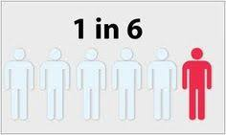
Older Adults DVA
Limited data and research into this area of domestic abuse.
Challenges around definitions and perception of domestic abuse in this population.
Systemic review suggests that 1 in 6 older adults experience domestic violence and abuse each year (Yon et al, 2017)

Slide 20
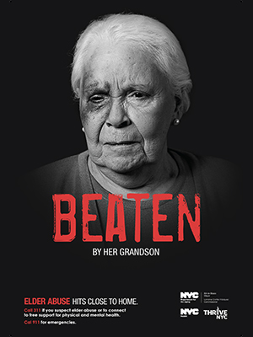
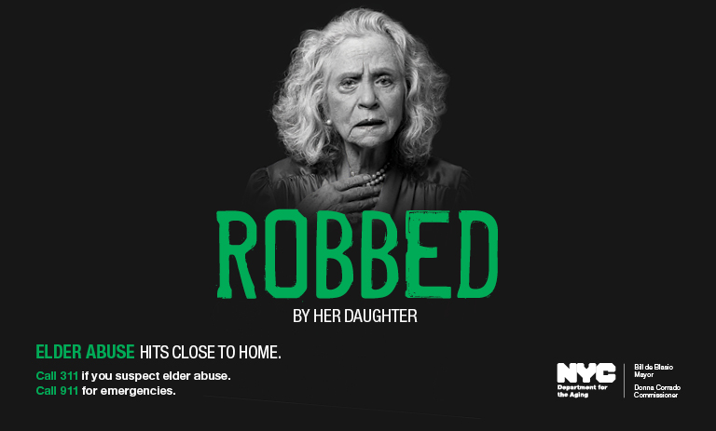
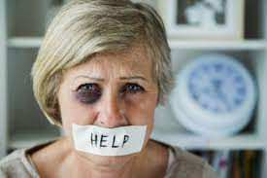
INVISIBILITY OF OF OLDER PEOPLE

Slide 21
The Challenge
Focus on this as a social concern, highlighting the differences rather than the sameness.
Portrayal of domestic violence and abuse in older adults as a societal/social issue.
Widely seen as something different to abuse perpetrated towards or by those who are younger, older adults seen as having inherent vulnerability.
Aged 59 aged 60
DOMESTIC VIOLENCE/RAPE/VAW ELDER ABUSE

Slide 22
Indicators of DVA?
It is important we use our professional curiosity to ask those difficult WHY questions.
John has no money, and has no food in his cupboards.
WHY?
Harry stays in his room and is always in bed.
WHY?
Clare’s husband will not allow care/nurse/GP visits.
WHY?
Mary has a black eye. Mary seems scared of her daughter.
WHY?
Jenny is showing signs of pain when she moves and sits down
WHY?

Slide 23
Indicators of DVA
John has no money, and has no food in his cupboards.
CONSIDER: Domestic abuse by controlling finances and neglect
Harry stays in his room and is always in bed.
CONSIDER: Domestic abuse by chemical restraint or enforced isolation
Mary has a black eye. Mary seems scared of her daughter.
CONSIDER: Domestic abuse through physical violence, coercion and control
Clare’s husband will not allow care/nurse/GP visits.
CONSIDER: Domestic abuse by control and coercion
Jenny is showing signs of pain when she moves and sits down
CONSIDER: Domestic violence by sexual assault/rape

Slide 24
Questions

Slide 25
References/Links
Braye, Suzy & Orr, David & Preston-Shoot, Michael. (2015). Serious case review findings on the challenges of self-neglect: Indicators for good practice. The Journal of Adult Protection. 17. 75-87. 10.1108/JAP-05-2014-0015. https://www.researchgate.net/publication/275248376_Serious_case_review_findings_on_the_challenges_of_self-neglect_Indicators_for_good_practice
Bows, H. (2018) ‘Domestic Homicide of Older People (2010-2015): A comparative analysis of intimate-partner homicide and parricide cases in the UK’. British Journal of Social Work, 49(5), 1234-1253. Available from: https://doi.org/10.1093/bjsw/bcy108
Bows, H. (2017) ‘Practitioner views on the impacts, challenges and barriers in supporting older survivors of sexual violence’. Violence Against Women, 24(9), 1070-1090. Available from: http://journals.sagepub.com/doi/full/10.1177/1077801217732348
Bows, H. and Westmarland, N. (2017) ‘Rape of Older People In The United Kingdom: Challenging The ‘Real Rape’ Stereotype. British Journal of Criminology, 57(1), 1-17. Available from: http://bjc.oxfordjournals.org/content/early/2015/11/24/bjc.azv116.full
Yon, Y.; Mikton, C.; Gassoumis, Z. and Wilber, K. (2017)Elder abuse prevalence in community settings: a systematic review and meta-analysis https://www.sciencedirect.com/science/article/pii/S2214109X17300062

